Slide 1
Chapter 2 Divide and Conquer

Slide 2
Contents
Recursion (concept, factorial, Hanoi)
Divide and Conquer
Binary Search
Strassen matrix multiplication
Merge Sort and Quick Sort
Linear time selection

Slide 3
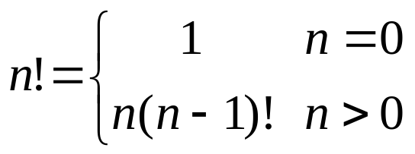
2.1 Recursion
Invoke itself directly or indirectly
Factorial
24
Factorial(4)
4*Factorial(3)
3*Factorial(2)
2*Factorial(1)
1*Factorial(0)
int Factorial(int n)
{
if (n==0) return 1;
return n*Factorial(n-1);
}
6
2
1
1

Slide 4
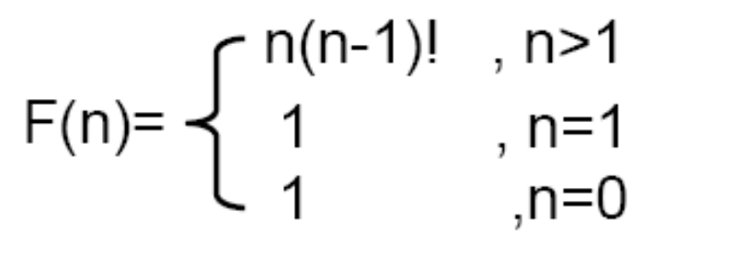
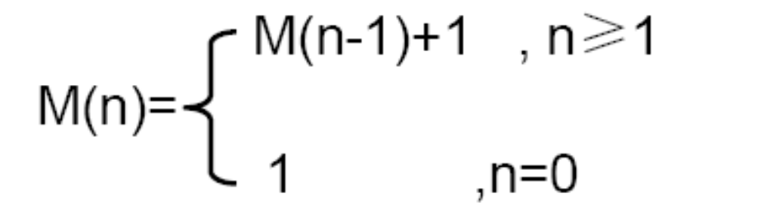
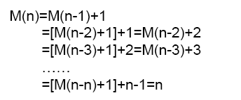
Time complexity
Software College, Northeast University neuzl@163.com

Slide 5
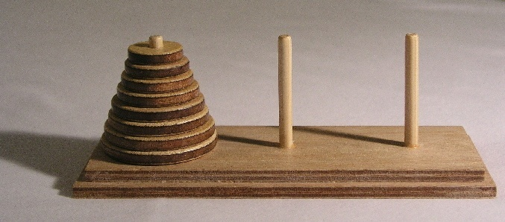
Example: Tower of Hanoi
It consists of three rods(杆) A, B and C, and a number of disks of different sizes which can slide onto any rod. The puzzle starts with the disks in a neat stack in ascending order of size on one rod, the smallest at the top, thus making a conical(圆锥) shape.
Software College, Northeast University neuzl@163.com

Slide 6
Example: Tower of Hanoi
The objective of the puzzle is to move the entire stack to another rod, obeying the following simple rules:
Only one disk can be moved at a time.
Each move consists of taking the upper disk from one of the stacks and placing it on top of another
No disk may be placed on top of a smaller disk.
With three disks, the puzzle can be solved in seven moves.
Software College, Northeast University zhangl@swc.neu.edu.cn

Slide 7
hanoi(n, A, B, C)
n＝1 move disc 1 from A to B directly
n>1
First : move n−1 discs from A to C. This leaves disc n alone on peg A
hanoi（n－1，A，C，B）
Second: move disc n from A to B
move(n, A, B);
Third ：Move n-1discs from C to B
hanoi（n－1，C，B，A）
A
B
C
①
no1
no1
no2
no2
③
no1
no3
no3
no2
②
no4
no4
no3
Software College, Northeast University zhangl@swc.neu.edu.cn

Slide 8
Tower of Hanoi
Void Hanoi(int n,int A,int B,int C)
{
if(n>0) {
Hanoi(n-1,A,C,B);
move(n,A,B);
Hanoi(n-1,C,B,A);
}
}
Moves times?
Software College, Northeast University zhangl@swc.neu.edu.cn

Slide 9
M( 1 ) = 1
M( n ) = 2M( n-1 ) + 1
= 2 [ 2M( n- 2 )+1]+1
= 2²M( n- 2 ) + 2 + 1
= 2³M( n- 3)+ 2² + 2 + 1
=……
= 2^{i}M( n – i ) + 2^{i-1} + 2^{i-2} +…… + 2 + 1
= 2^{i}M( n – i ) + 2^{i} - 1
suppose i= n -1
Then M(n)= 2^{n-1} + 2^{n-1}-1=2^{n}-1
Software College, Northeast University zhangl@swc.neu.edu.cn

Slide 10
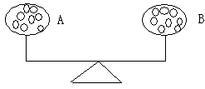
The divide-and-conquer design paradigm
Fake coin problem
There are 16 coins in the bag. One of the 16 coins is counterfeit, and that counterfeit coin is lighter than the real coin. Your task is to find out this forged coin. An instrument will be provided to compare the weight of two sets of coins. With this instrument, you can know whether the weights of the two sets of coins are the same.
Software College, Northeast University zhangl@swc.neu.edu.cn

Slide 11
The divide-and-conquer design paradigm
First method
Compare each other of them, 8 comparisons at worst
Second method
Divide them into two parts A and B, every part include 8 coins.
Compare A and B. The fake one will be in the lighter part. Then repeat the first step
Software College, Northeast University zhangl@swc.neu.edu.cn

Slide 12
The divide-and-conquer design paradigm
There is a boss with a bag of gold nuggets. Each month, two employees will be awarded a gold nugget for their outstanding performance. According to the rules
the number one employee will get the heaviest gold nugget
the number two employee will get the lightest gold nugget in the bag.
Suppose there is a relatively heavy instrument, and we want to find the lightest and heaviest gold nuggets with the least number of comparisons.
Software College, Northeast University zhangl@swc.neu.edu.cn

Slide 13
The divide-and-conquer design paradigm
Suppose there are n gold nuggets. Find the heaviest one through n-1 comparisons. After finding the heaviest one, find the lightest gold nugget from the remaining n-1 gold nuggets in a similar way. Thus, the total number of comparisons is 2n-3.
When n≤2, only one comparison.
when n＞2,
First, divide gold nuggets into two small bags A and B..
Second, find the heaviest and lightest nuggets in A and B, respectively. HA and LA, HB and LB..
Third, by comparing HA and HB, you can find the heaviest one; by comparing LA and LB, you can find the lightest one.
Software College, Northeast University zhangl@swc.neu.edu.cn

Slide 14

c(n) is comparisons. Suppose n is a power of 2.
  When n= 2，c(n) = 1；
  When n>2，c(n) = 2c(n/ 2 ) + 2。When n is a power of 2, c(n) = 3n/ 2 - 2。
So the comparisons are 25% less than normal method
Software College, Northeast University zhangl@swc.neu.edu.cn

Slide 15
Divide and Conquer
The most well known algorithm design strategy:
Divide instance of problem into two or more smaller instances
Solve smaller instances recursively
Obtain solution to original (larger) instance by combining these solutions
Software College, Northeast University zhangl@swc.neu.edu.cn

Slide 16
Divide-and-conquer technique
a problem
of size n
subproblem 1
of size n/2
subproblem 2
of size n/2
a solution to
subproblem 1
a solution to
subproblem 2
a solution to
the original problem
zhangl@swc.neu.edu.cn

Slide 17
Divide-and-conquer technique
P is input
Divide-and-Conquer(P)
{
if (|P|<=n0) Adhoc(P);
divide P into smaller subinstances
P1,P2,···,Pk;
for(i=1;i<=k;i++)
yi=Divide-and-Conquer (Pi);
return Merge(y1,···,yk);
}
If p is small enough
Solve it
Partition
conquer
Software College, Northeast University zhangl@swc.neu.edu.cn
Merge the subresults

Slide 18
General Divide and Conquer recurrence:
T(n) = aT(n/b) + f (n) where f (n) ∈ Θ(n^{k})
a < b^{k} T(n) ∈ Θ(n^{k})
a = b^{k} T(n) ∈ Θ(n^{k} lg n )
a > b^{k} T(n) ∈ Θ(n^{log b a})
Note: the same results hold with O instead of Θ.
Notes:
This is the same slide from chapter 2 (analysis of recursive algorithms)
It is a good idea to remind students at this point and do some examples especially
if you went over this quickly and did not do examples the previous time.
Here are examples from before:
T(n) = T(n/2) + 1
T(n) = 2T(n/2) + n
T(n) = 3 T(n/2) + n
=> this last example is important to mention at some point:
Θ(n^{log}₂³)
NB: cannot “eliminate” or simplify this constant

Slide 19
Divide and Conquer Examples
Binary search
Sorting: mergesort and quicksort
Tree traversals
Matrix multiplication-Strassen’s algorithm

Slide 20
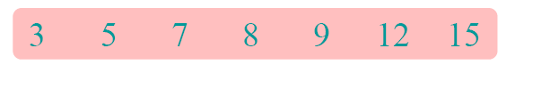
Binary search
Find an element in a sorted array:
1. Divide: Check middle element.
2. Conquer: Recursively search 1 subarray.
3. Combine: Trivial.
Example: Find 9

Slide 21

Binary search
Find an element in a sorted array:
1. Divide: Check middle element.
2. Conquer: Recursively search 1 subarray.
3. Combine: Trivial.
Example: Find 9

Slide 22
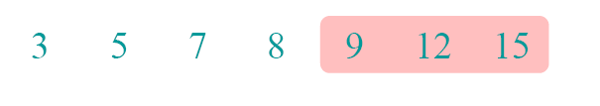
Binary search
Find an element in a sorted array:
1. Divide: Check middle element.
2. Conquer: Recursively search 1 subarray.
3. Combine: Trivial.
Example: Find 9

Slide 23

Binary search
Find an element in a sorted array:
1. Divide: Check middle element.
2. Conquer: Recursively search 1 subarray.
3. Combine: Trivial.
Example: Find 9

Slide 24

Binary search
Find an element in a sorted array:
1. Divide: Check middle element.
2. Conquer: Recursively search 1 subarray.
3. Combine: Trivial.
Example: Find 9

Slide 25

Binary search
Find an element in a sorted array:
1. Divide: Check middle element.
2. Conquer: Recursively search 1 subarray.
3. Combine: Trivial.
Example: Find 9

Slide 26
Binary Search
template<class T>
int BinarySearch( T a[], const T& x, int n)
{//在a[0]<=a[1]<=···<=a[n-1]中搜索x
//如果找到，则返回所在位置，否则返回 –1
int left= ; int right= ;
while( ){
int middle= ;
if(x==a[middle]) return middle;
if(x>a[middle]) left= ;
else right= ;
}
return –1; //未找到x
}
0
n-1
left<=right
(left+right)/2
middle+1
middle – 1
Software College, Northeast University zhangl@swc.neu.edu.cn

Slide 27
Search 27, 12, 14 in the list [9,12,15,27,39]
0 1 2 3 4
mid = (left+right)/2
=(0+4)/2=2
9 12 15 27 39
left
mid
right
mid =(3+4)/2=3
9 12 15 27 39
mid
left
right
查找27成功返回3，left<right
9 12 15 27 39
left
right
mid
9 12 15 27 39
查找12成功返回1,left=right
left
mid
right
9 12 15 27 39
查找14失败返回-1,left>right
right
Software College, Northeast University zhangl@swc.neu.edu.cn
left

Slide 28

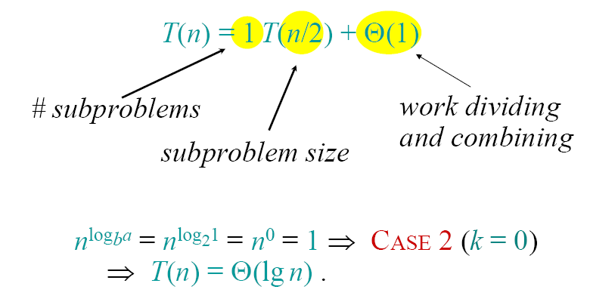
Recurrence for binary search

Slide 29
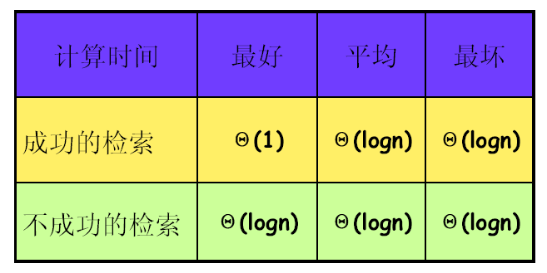
Complexity of Binary search
Software College, Northeast University zhangl@swc.neu.edu.cn

Slide 30
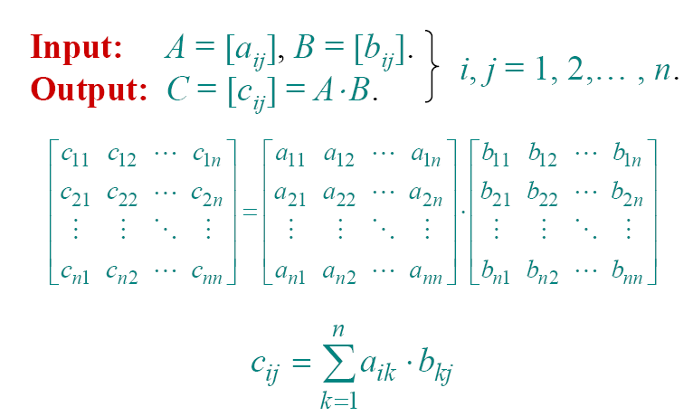
Strassen’s matrix multiplication
C= A B
Traditional method：
Computational complexity: O(n³)
Software College, Northeast University zhangl@swc.neu.edu.cn

Slide 31
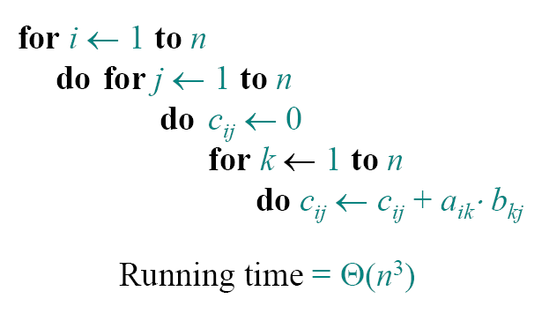
Standard algorithm

Slide 32
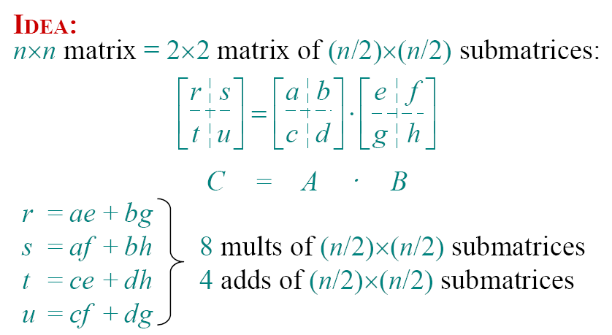
Divide-and-conquer algorithm

Slide 33
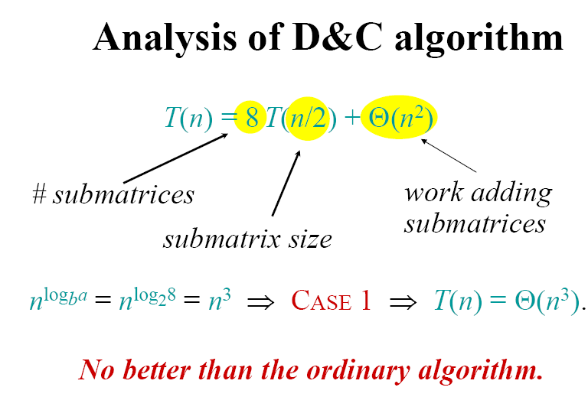

Slide 34












Strassen’s matrix multiplication
Divide and conquer:
Software College, Northeast University zhangl@swc.neu.edu.cn

Slide 35
Submatrices:
M₁ = (A₀₀ + A₁₁) * (B₀₀ + B₁₁)
M₂ = (A₁₀ + A₁₁) * B₀₀
M₃ = A₀₀ * (B₀₁ - B₁₁)
M₄ = A₁₁ * (B₁₀ - B₀₀)
M₅ = (A₀₀ + A₀₁) * B₁₁
M₆ = (A₁₀ - A₀₀) * (B₀₀ + B₀₁)
M₇ = (A₀₁ - A₁₁) * (B₁₀ + B₁₁)
7 mults, 18 adds/subs.
Note: No reliance on commutativity of mult

Slide 36
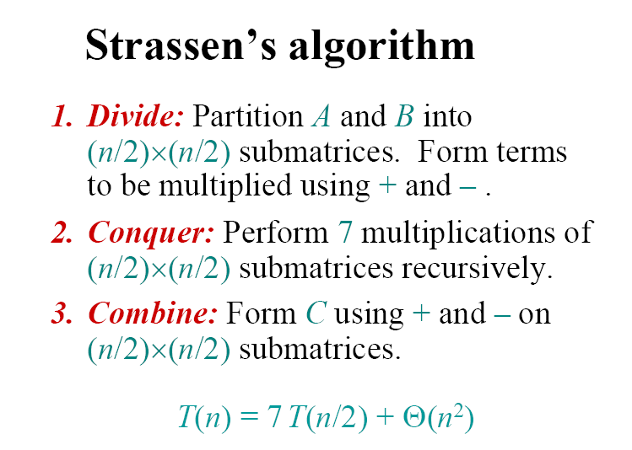

Slide 37
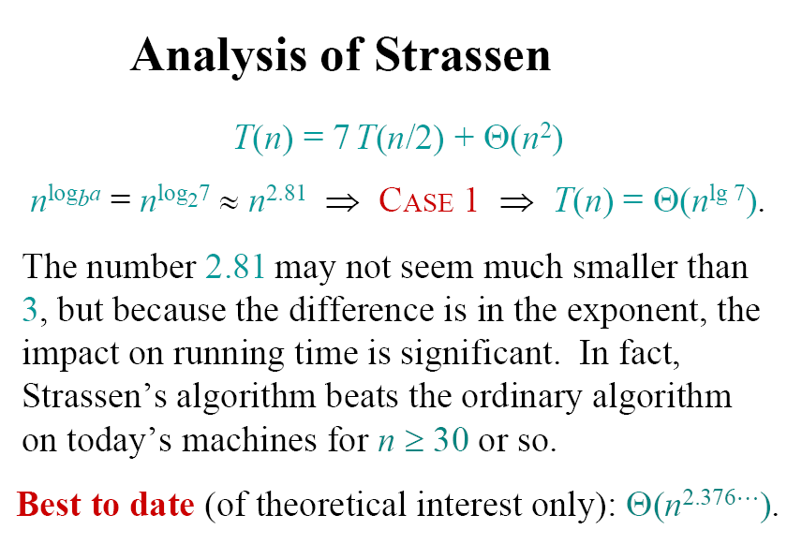

Slide 38
Strassen’s matrix multiplication
Traditional method: O(n³)
Divide and Conquer: O(n^{2.81})
Is there any better algorithm?
Hopcroft and Kerr had proved. 7 times multiplication is necessary for 2×2 matrix.
The best algorithm for matrix multiplication is about O(n^{2.376}) untill now
Software College, Northeast University zhangl@swc.neu.edu.cn

Slide 39
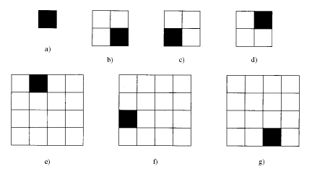

Chessboard problem
There is a 2^{k}×2^{k} chessboard. one of it is a special grid. Use a L type board to cover this chessboard. Any two three grid plate cant overlap and cant cover the special grid
Software College, Northeast University zhangl@swc.neu.edu.cn

Slide 40
For any k，there are 2^{k}*2^{k} different chessboards
Software College, Northeast University neuzl@163.com

Slide 41
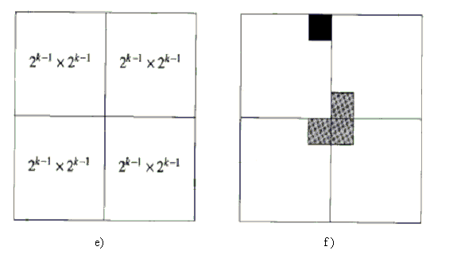
Software College, Northeast University zhangl@swc.neu.edu.cn

Slide 42

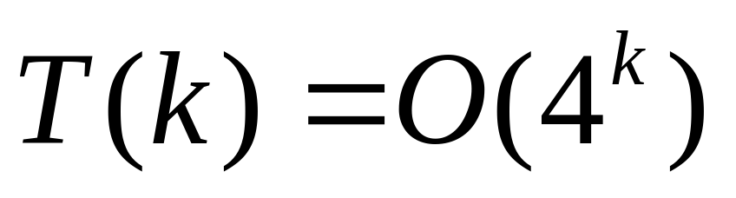
令t (k) 为覆盖一个2^{k}×2^{k} 残缺棋盘所需要的时间。当k= 0时，s i z e等于1，覆盖它将花费常数时间d。当k > 0时，将进行4次递归的函数调用，这些调用需花费的时间为 4t (k-1 )。除了这些时间外， if 条件测试和覆盖3个非残缺方格也需要时间，假设用常数c 表示这些额外时间。可以得到以下递归表达式：
Software College, Northeast University zhangl@swc.neu.edu.cn

Slide 43
Mergesort
template <class Type>
INSERTIONSORT( Type A[ ], int n)
{ Type item;
int i;
for( int j=1; j< n ; j++)
{
item=A[ j ];
i= j -1;
while( item<A[ i ] && i>-1) do
{ A[i+1]=A[i];
i=i-1;
}
A[i+1]=item;
}
}
数组元素的移动
可能执行0~j次(j=1,2…n-1)
最坏情况的计算时间：2+…+n=(n(n+1)/2)-1= Θ(n²)，最好情况Ω(n)
插入排好序的值
Software College, Northeast University neuzl@163.com

Slide 44
Mergesort
Algorithm:
Split array A[1..n] in two and make copies of each half
in arrays B[1.. n/2 ] and C[1.. n/2 ]
Sort arrays B and C
Merge sorted arrays B and C into array A as follows:
  Repeat the following until no elements remain in one of the arrays:
    compare the first elements in the remaining unprocessed portions of the arrays
    copy the smaller of the two into A, while incrementing the index indicating the unprocessed portion of that array
  Once all elements in one of the arrays are processed, copy the remaining unprocessed elements from the other array into A.

Slide 45
Mergesort
Void MergeSort(type a[ ], int left, int right)
{
if left<right //at least two elements
{
find the middle index “mid”
Recursive invoke itself from “left” to “mid”
Recursive invoke itself from “mid” to “right”
Merge two sorted subresult
}
}
Software College, Northeast University zhangl@swc.neu.edu.cn

Slide 46
Mergesort
template<class Type>
void MergeSort(Type a[ ], int left, int right)
{// A[left:right]是一个全程数组，含有 right-left+1个待排序的元素。
if ( ) { //至少有2个元素
int mid = (left+right)/2; //求当前数组的分割点
MergeSort(a，left, mid);
MergeSort(a，mid+1, right);
Merge(a，b，left, mid ,right);
copy（a，b，left，right）；
}
} 排序树
left < right
递归调用，分别对分解出来的两个子问题排序
合并两个排好序的子问题，放入另一个数组b中
Software College, Northeast University zhangl@swc.neu.edu.cn

Slide 47
Merge(a,b,left,mid,right)
a
b
2,4,5,8
1,3,6,7
2,4,5,8
1,3,6,7
1
1,2,3,4,5,6
2,4,5,8
1,3,6,7
1,2
2,4,5,8
1,3,6,7
2,4,5,8
1,3,6,7
1,2,3
1,2,3,4,5,6,7
2,4,5,8
1,3,6,7
1,2,3,4
1,2,3,4,5,6,7,8
2,4,5,8
1,3,6,7
1,2,3,4,5
Software College, Northeast University zhangl@swc.neu.edu.cn

Slide 48
Consider two parts of array a are [1, 7, 8, 9] and [2, 3, 4, 5]
a
b
1,7,8,9
2,3,4,5
1
1,2,3,4,5,7
1,7,8,9
2,3,4,5
1,2
1,2,3,4,5,7,8
1,7,8,9
2,3,4,5
1,2,3
1,2,3,4,5, 7,8,9
1,7,8,9
2,3,4,5
1,2,3,4
1,7,8,9
2,3,4,5
1,2,3,4,5
Software College, Northeast University zhangl@swc.neu.edu.cn

Slide 49
MERGE function
Sorted array A
Sorted array B
Array A
A(0) | A(1) | A(2) | … | A(⎣(n-1)/2⎦) | A(⎣(n-1)/2⎦+1) | … | A(n-1)
compare
compare
Left elements
……
Array B
A(0)
A(⎣(n-1)/2⎦+1)
Software College, Northeast University zhangl@swc.neu.edu.cn

Slide 50
Merge function
template< class Type >
void Merge( Type a[ ], Type b[ ], int l, int m, int r)
{//合并a[l:m]和a[m+1:r]到b[l:r]
int i=l;
j=m+1,
k=l;
while( ( )&&( ) )
if( a[ i ]<=a[ j ]) b[ k++ ]=a[ i++ ];
else b[ k++ ]=a[ j++ ];
if( i>m ) for( int q=j; q<=r; q++ )
b[ k++ ]=a[ q ];
else for( int q=I; q<=m; q++)
b[ k++ ]=a[ q ];
}
后半段指针
把a[l:m]和a[m+1:r]中的数据进行比较，按顺序放入b[]中
前半段指针
数组b的下标指针
i<=m
j<=r
如果前一段数据小于后一段的多，则先排完，把后段剩余数付给b[n],否则将前段数据付给b[n]
Software College, Northeast University neuzl@163.com

Slide 51
Merge function
310 285 179 652 351 423 861 254 450 520
④
③
②
①
285 310 179 652 351 423 861 254 450 520
③
②
①
179 285 310 652 351 423 861 254 450 520
②
⑤
①
179 285 310 351 652 423 861 254 450 520
②
①
179 285 310 351 652 423 861 254 450 520
①
Software College, Northeast University neuzl@163.com

Slide 52
Merge Function
179 285 310 351 652 423 861 254 450 520
①
Recursive invoke , merge
179 285 310 351 652 254 423 450 520 861
①
merge
179 254 285 310 351 423 450 520 652 861
Software College, Northeast University neuzl@163.com

Slide 53
MERGESORT invoke tree
Low and high
0,9
0,4
5,9
0,2
3,4
5,7
8,9
0,1
2,2
3,3
4,4
5,6
7,7
8,8
9,9
Only one element
0,0
1,1
5,5
6,6
Software College, Northeast University neuzl@163.com

Slide 54
MERGESORT invoke tree
0，0，1
5，5，6
low,mid,high
0，1，2
3，3，4
5，6，7
8，8，9
0，2，4
5，7，9
Merge A(0:2) and A(3:4)
0，4，9
Software College, Northeast University neuzl@163.com

Slide 55
Analysis of Merge Sort
Complexity of merging two lists of length n₁ and n₂:
After each comparison, one key is moved to the merged list
⇒ at most (n₁ + n₂ –1) comparisons
Worst case : W(n) = W(⎣n/2⎦) + W(⎡n/2⎤) + n − 1
W(1) = 0
W(n) ≈ n log n − n
= Θ(n log n)
Average case ≈ Worst case
Mergesort does about 30% fewer comp. in the w.case than Quicksort in the av.case.
But it does more element movement on average.
Space complexity: an extra amount of n locations needed
not in-place
Software College, Northeast University neuzl@163.com

Slide 56
Space Usage of Merge Sort
Space Saving
  Suppose n ≥ m.
  Give an array A extra m locations.
  Merge from the ends (larger keys) of A and B.
not in-place
A
B
1 n n+m 1 m
Software College, Northeast University neuzl@163.com

Slide 57
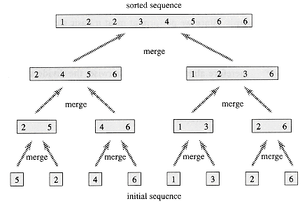
Merge sort without recursion
Software College, Northeast University neuzl@163.com

Slide 58
Quicksort (C.A.R. Hoare 1960)
first
last
x
Choose a pivot element & pull it out of the way & put in E[SplitPoint]
first
SplitPoint
last
≤ x
x
> x
Sort recursively
Sort recursively
By Quicksort
Procedure Quicksort(first, last)
if first < last then
pivot := first (or some other index, depending on a strategy)
Split(first, last, pivot, SplitPoint);
Quicksort(first, SplitPoint-1);
Quicksort(SplitPoint+1, last);
end{if}
Software College, Northeast University neuzl@163.com

Slide 59
Example
6 2 11 4 3 12 5 9 7 8
2 4 3 5 (6) 11 12 9 7 8
(2) 4 3 5
9 7 8 (11) 12
3 (4) 5
7 8 (9)
(7) 8
2 3 4 5 6 7 8 9 11 12
Software College, Northeast University neuzl@163.com

Slide 60
Steps
(Divide): take a[p] as pivot. Divide a[p:r] into a[p:q-1], a[q] and a[q+1:r].
(conquer):Recursive quicksort to a[p:q-1] and a[q+1:r].
Software College, Northeast University neuzl@163.com

Slide 61
QuickSort
a的起始位置
Template<class Type>
void QuickSort(Type a[ ], int p,int r)
{
if(p<r){
int q=Partition(a,p,r);
QuickSort(a,p,q-1);//对左半段排序
QuickSort(a,q+1,r);//对右半段排序
}
}
A的终止位置
Partition函数负责将a进行一次分割，返回分割元素的位置
Software College, Northeast University neuzl@163.com

Slide 62
Partition
(1) | (2) | (3) | (4) | (5) | (6) | (7) | (8) | (9) | (10) | i | p
65 | 70 | 75 | 80 | 85 | 60 | 55 | 50 | 45 | +∞ | 2 | 9
65 | 45 | 75 | 80 | 85 | 60 | 55 | 50 | 70 | +∞ | 3 | 8
65 | 45 | 50 | 80 | 85 | 60 | 55 | 75 | 70 | +∞ | 4 | 7
65 | 45 | 50 | 55 | 85 | 60 | 80 | 75 | 70 | +∞ | 5 | 6
65 | 45 | 50 | 55 | 60 | 85 | 80 | 75 | 70 | +∞ | 6 | 5
60 | 45 | 50 | 55 | 65 | 85 | 80 | 75 | 70 | +∞
Software College, Northeast University neuzl@163.com

Slide 63
Partition
Scan the subrange two times: from left to right, from right to left. Compare all the elements with pivot.
The scan from left to right will begin from the second element, and will stop until the first element which is less than pivot.
The scan from right to left will begin from the last element. It will stop until the first element which is bigger than pivot.
Software College, Northeast University neuzl@163.com

Slide 64
i
j
P | <=p | >=p | ····· | <=p | >=p
如果扫描指针i和j不相交，i<j, 简单交换A[i]和A[j]，再分别对i加一，j减一，然后继续扫描
j
i
P
全部<=p
<=p
>=p
全部>=p
如果扫描指针i和j相交，i>j, 把中轴和A[j]交换，得到该数组的一个分区。
i=j
P
全部<=p
=p
全部>=p
如果扫描指针i指向同一元素，i＝j，被指向元素的值一定等于p。
Software College, Northeast University neuzl@163.com

Slide 65
Partition
template<class Type>
int Partition(Type a[ ],int p,int r)
{
int i = ,
j = ;
Type x = ;
while( true ) {
while( a[ ++i ]<x );
while( a[ - - j ]>x );
if( ) break;
Swap( a[ i ], a[ j ] );
}
a[ p ] = ;
a[ j ] = ;
return j;
}
左侧扫描指针起始
右侧扫描指针起始
p
r+1
中轴元素
a[ p ]
移动左侧扫描指针
移动右侧扫描指针
i >= j
a[ j ]
x
Software College, Northeast University neuzl@163.com

Slide 66
example：sort 5，3，1，9，8，2，4，7
0 1 2 3 4 5 6 7
i j
2 3 1 4
i j
5 3 1 9 8 2 4 7
i j
8 9 7
i j
2 3 1 4
i j
5 3 1 9 8 2 4 7
j i
8 7 9
i j
2 1 3 4
i j
5 3 1 4 8 2 9 7
7 8 9
7
j i
2 1 3 4
9
i j
5 3 1 4 8 2 9 7
1 2 3 4
i j
5 3 1 4 2 8 9 7
1
i j
3 4
j i
5 3 1 4 2 8 9 7
j i
3 4
2 3 1 4 5 8 9 7
4
Software College, Northeast University neuzl@163.com

Slide 67
Efficiency of quicksort
Best case: split in the middle — Θ( n log n)
Worst case: sorted array! — Θ( n²)
Average case: random arrays — Θ( n log n)
Improvements:
  better pivot selection: median of three partitioning avoids worst case in sorted files
  switch to insertion sort on small subfiles
  elimination of recursion
  these combine to 20-25% improvement
Considered the method of choice for internal sorting for large files (n ≥ 10000)
Software College, Northeast University neuzl@163.com

Slide 68
How fast can we sort?
Depends on the model
Quick sort & Merge sort in Θ(nlogn)
Insertion sort Θ(n²)
Can we do better than Θ(nlogn) ?
No comparison sorting algorithm run better than nlogn.
Outside the comp. sort it might get linear!
Why we need nlogn?
Decision Trees

Slide 69
Decision Trees (to recall)
For any n there is a class of searching algorithms (decision trees)
1 2 3 4 5 6 7 8 9 10 11
1
2
3
4
5
6
7
8
9
10
11
4
8
9
10
11
6
1
5
3
9
2
6
1
4
7
10
3
7
2
5
8
11

Slide 70
Decision Trees for sorting by comparisons
Assume that the keys are distinct. (a₁, a₂,··· ,a_{n})
Decision Tree
a₁ a₂ a₃
n = 3
If a[1]<a[2]
1:2
If a[1]>a[2]
2:3
1:3
a₁,a₂,a₃
1:3
a₂,a₁,a₃
2:3
a₁,a₃,a₂
a₃,a₁,a₂
a₂,a₃,a₁
a₃,a₂,a₁
a particular input → a path from the root to a leaf
the number of comparisons → path length
6 possible inputs ⇒ 6 leaves the tree must have at least n! leaves
number of comparisons in the worst case = depth of decision tree = 3
“height of the tree”
average number of comparisons
= average lengths of all paths from the root to a leaf = 2+2/3
=[(4x3)+(2x2)]/6

Slide 71

Lower bounds for Sorting by comparison
Worst case number of comparisons in the worst case = depth of decision tree
L : number of leaves in a decision tree ≥ n!
d: the depth of a decision tree
L ≤ 2^{d} T2,Q1(d)
d ≥ log L
d ≥ log n!
Any alg. must do at least ⎡log n!⎤ in the worst case
How close ⎡log n!⎤ is to n log n ?
So d is at least ⎡ n log n – 1.443n ⎤ key comp.
MergeSort is optimal !
Stirling approx.
n! ≥ (n/e)^{n}
log n! > n log (n/e)
n log n –n log e
= n log n – 1.443n
Average Behavior
  average path length ≥ ⎣log L⎦
  average number of comparisons ≥ ⎣log n!⎦ ~ n log n – 1.443n
very close

Slide 72
计数排序、冒泡排序、插入排序、选择排序、归并排序和快速排序的时间复杂性如下：
算法 最坏复杂性 平均复杂性
冒泡排序 n² n²
计数排序 n² n²
插入排序 n² n²
选择排序 n² n²
快速排序 n² n log n
归并排序 n log n n log n
Software College, Northeast University neuzl@163.com

Slide 73
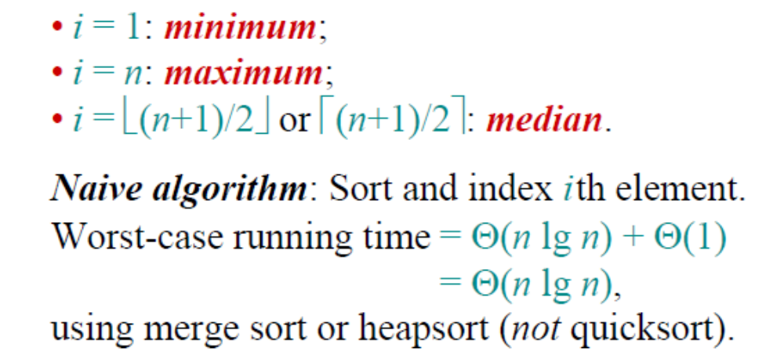
Linear time selection
Select the ith smallest of n elements (the
element with rank i).
Software College, Northeast University neuzl@163.com

Slide 74
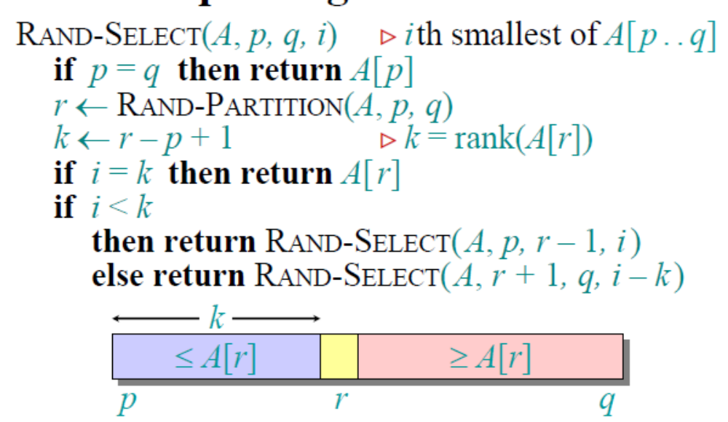
Randomized divide-and-conquer algorithm
Software College, Northeast University neuzl@163.com

Slide 75
template<class Type>
Type RandomizedSelect(Type a[ ],int p,int r,int k)
{
if(p == r) return a[ p ];
int i = RandomizedPartition( a, p, r );
j= i – p + 1;
if ( k <= j) return RandomizedSelect( a,p,i,k);
else return RandomizedSelect(a,i+1,r,k-j);
}
Software College, Northeast University neuzl@163.com

Slide 76
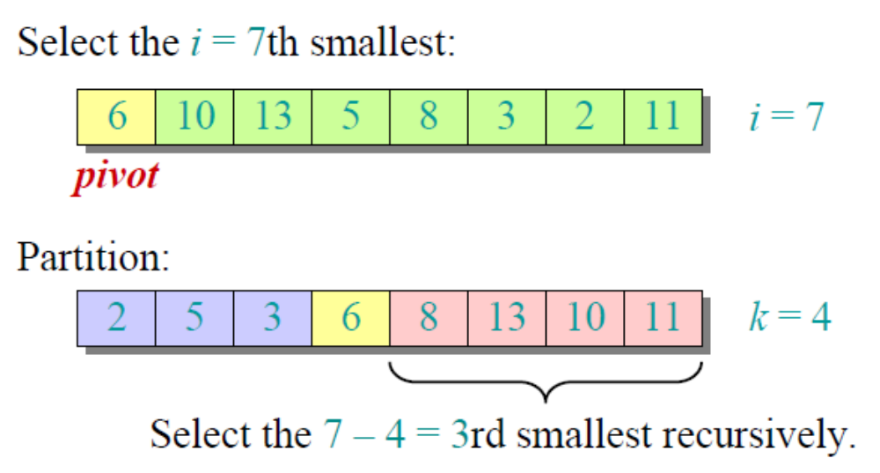
Example
Software College, Northeast University neuzl@163.com

Slide 77
Example
4，1，10，9，7，12，8，2，15, select the i = 5th smallest:
First : Randomizedpartition(a, 1, 9)= 3
Output: 2 1 4 9 7 12 8 10 15
5>3，then RandomizedSelect( a, 4, 9, 2)
Second: Randomizedpartition(a, 4, 9)=6
Output: 2 1 4 8 7 9 12 10 15
5<6，then RandomizedSelect( a, 4, 6, 2)
Third: Randomizedpartition(a, 4, 6)=5
Then 2 1 4 7 8 9 12 10 15

Slide 78
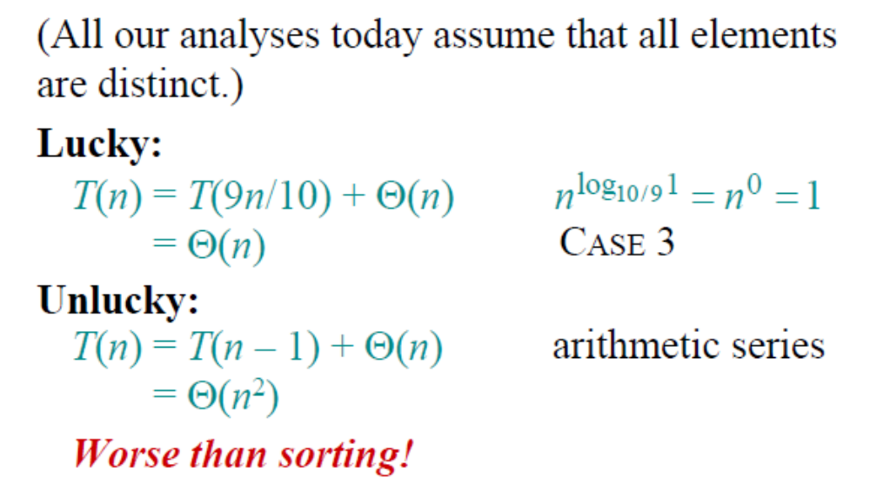
Intuition for analysis
Software College, Northeast University neuzl@163.com

Slide 79
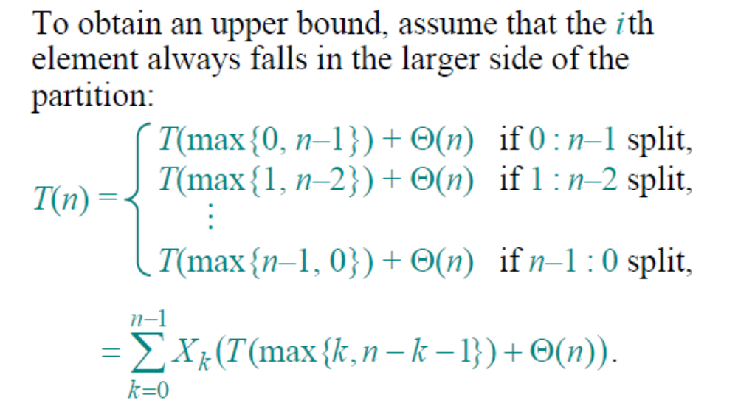
Analysis( continued)
Software College, Northeast University neuzl@163.com

Slide 80
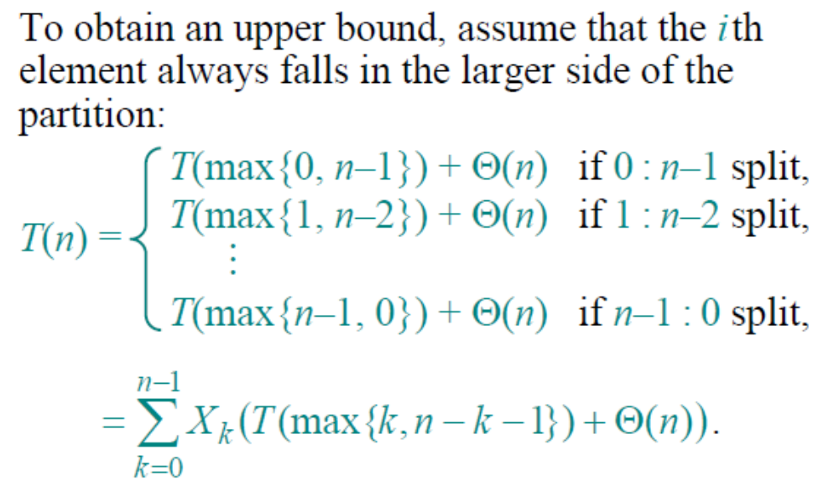
Calculating expectation
Software College, Northeast University neuzl@163.com

Slide 81
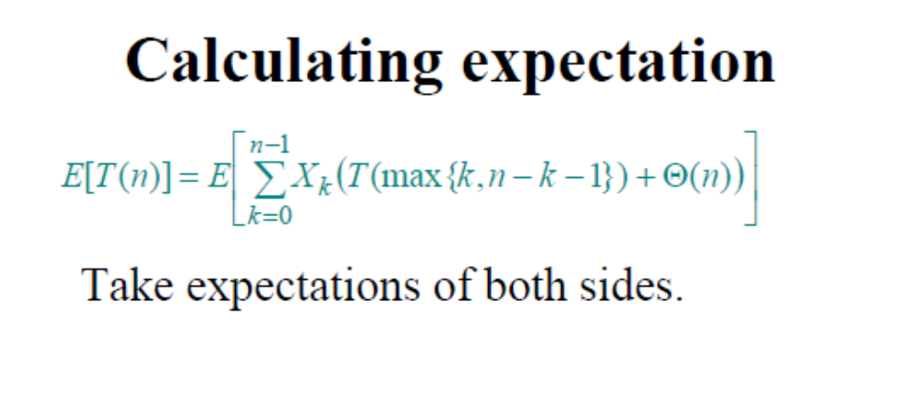
Software College, Northeast University neuzl@163.com

Slide 82
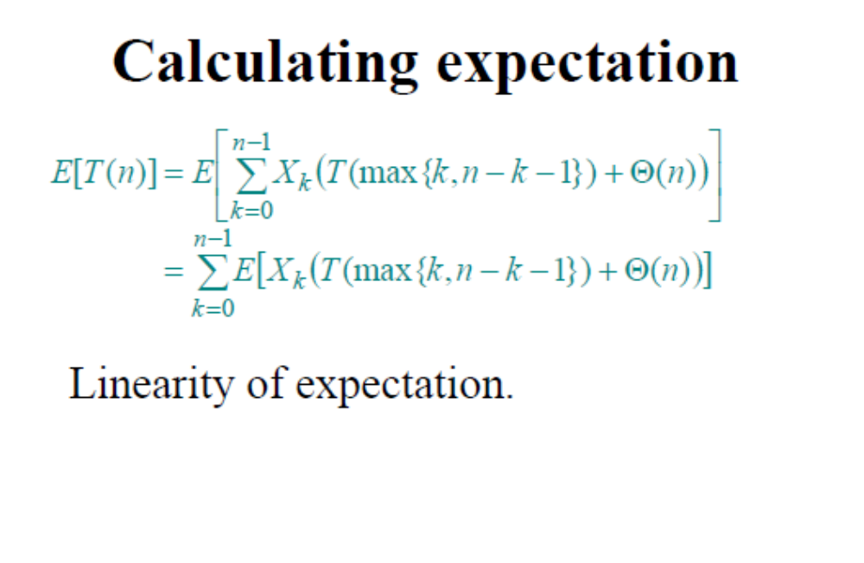
Software College, Northeast University neuzl@163.com

Slide 83
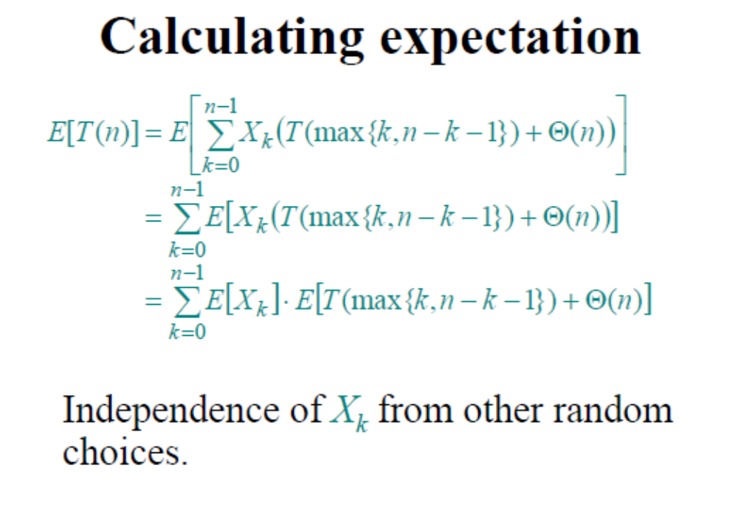
Software College, Northeast University neuzl@163.com

Slide 84
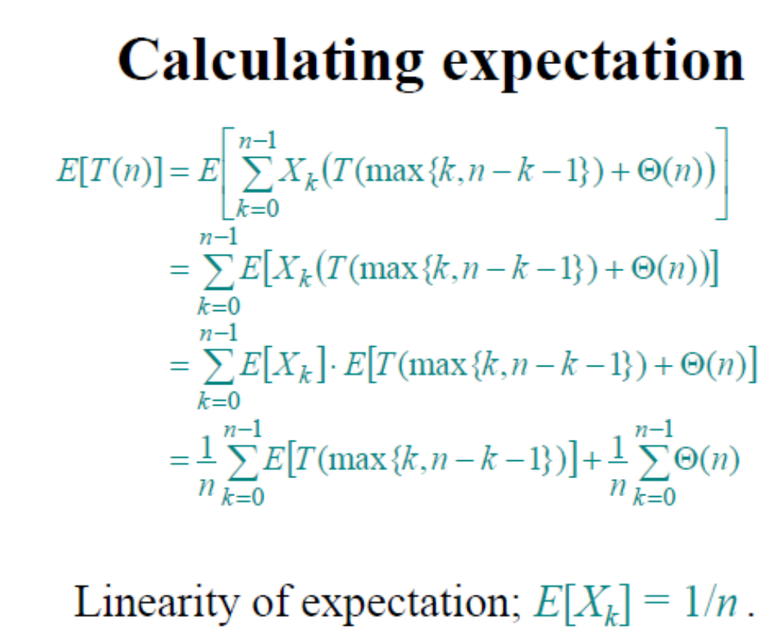
Software College, Northeast University neuzl@163.com

Slide 85
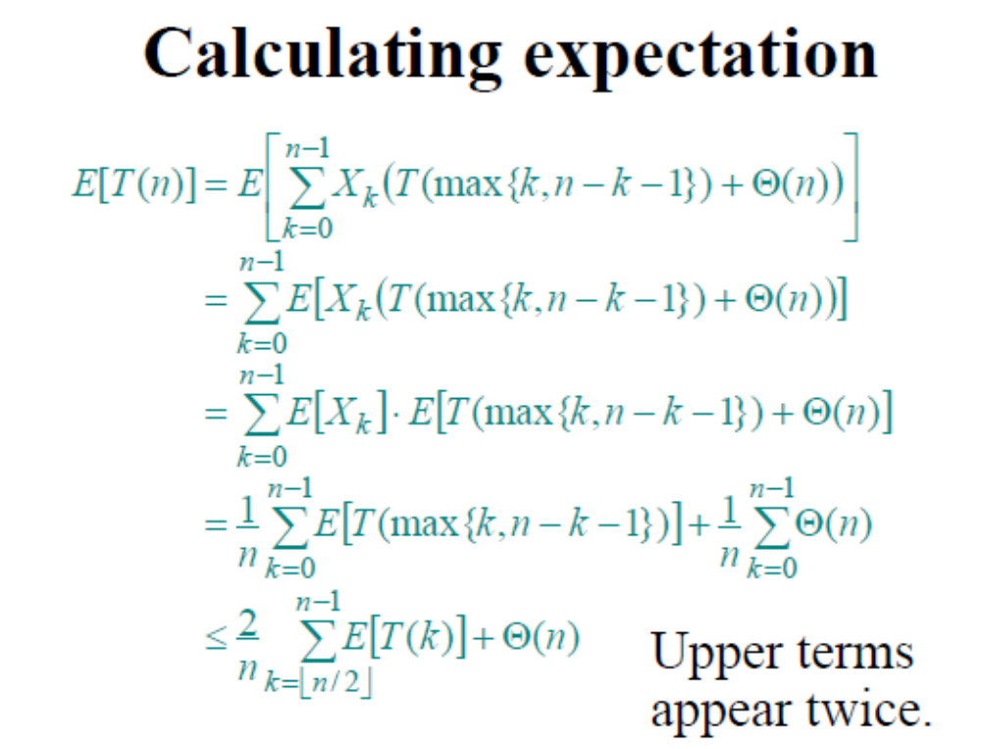
Software College, Northeast University neuzl@163.com

Slide 86
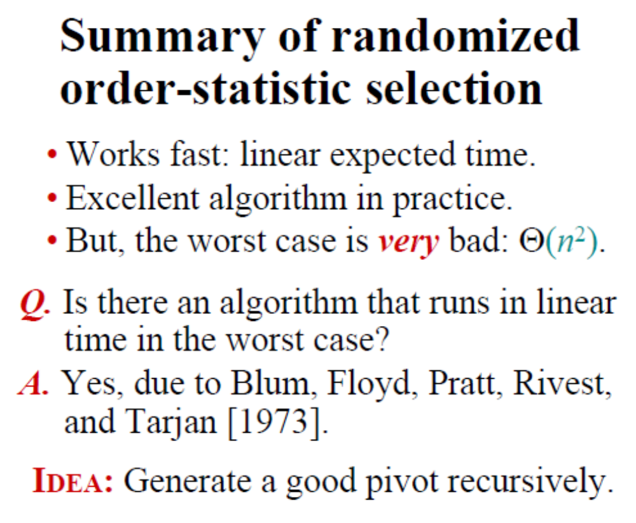
Software College, Northeast University neuzl@163.com

Slide 87
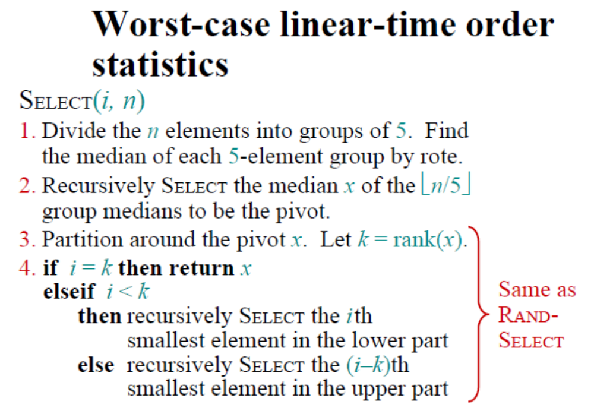
Software College, Northeast University neuzl@163.com

Slide 88
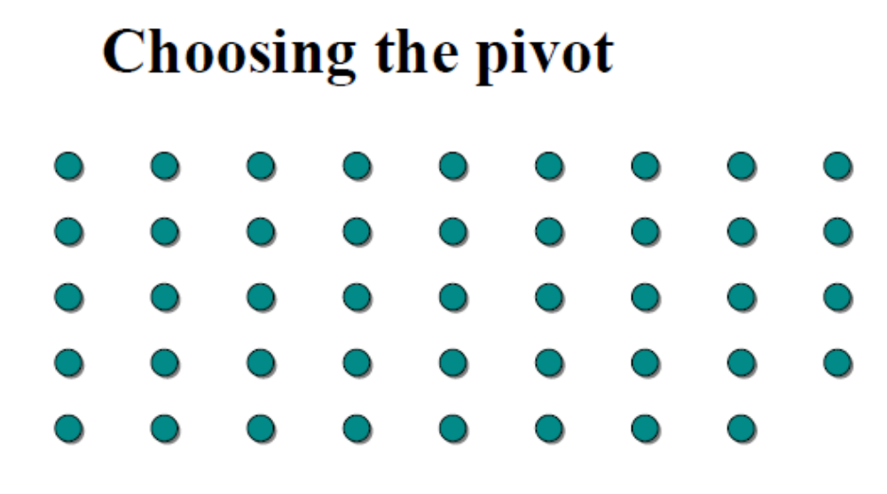
Software College, Northeast University neuzl@163.com

Slide 89
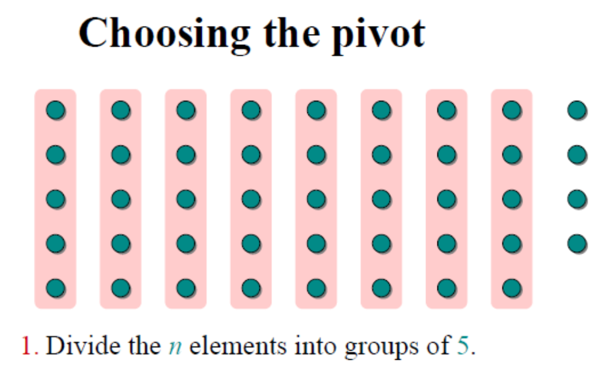
Software College, Northeast University neuzl@163.com

Slide 90
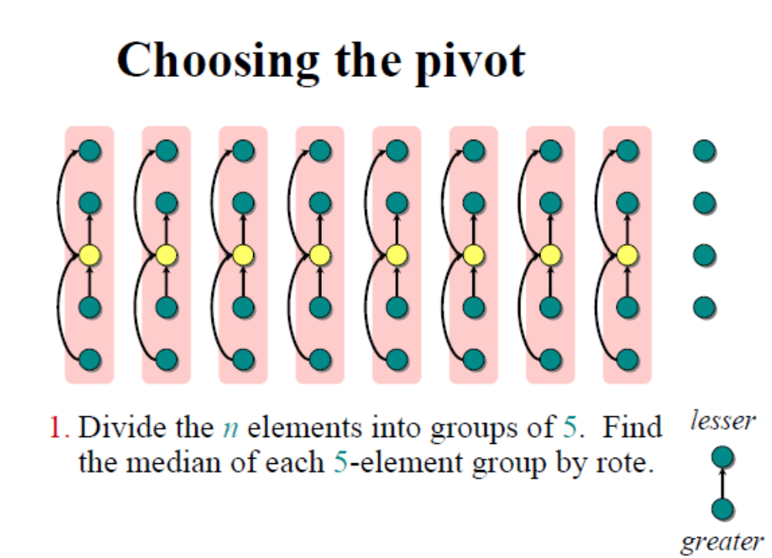
Software College, Northeast University neuzl@163.com

Slide 91
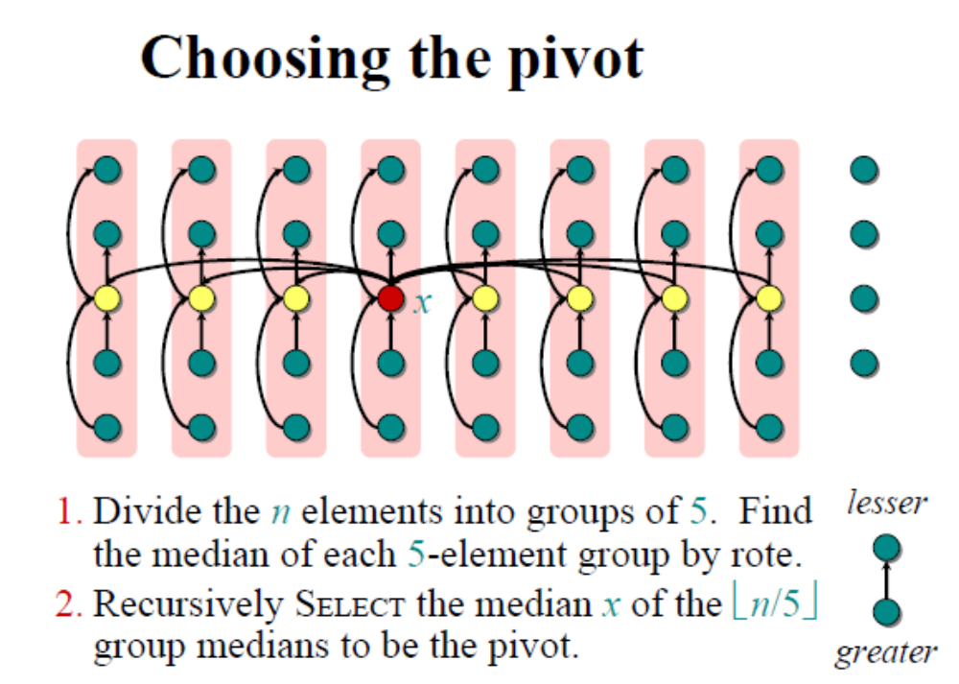
Software College, Northeast University neuzl@163.com

Slide 92
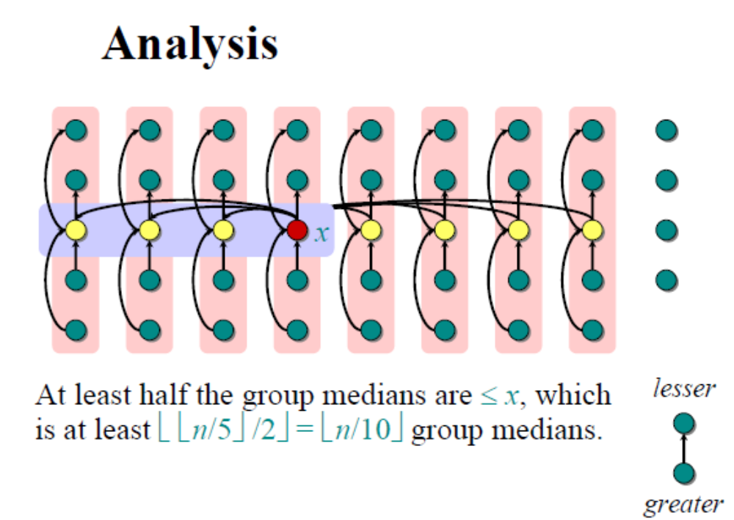
Software College, Northeast University neuzl@163.com

Slide 93
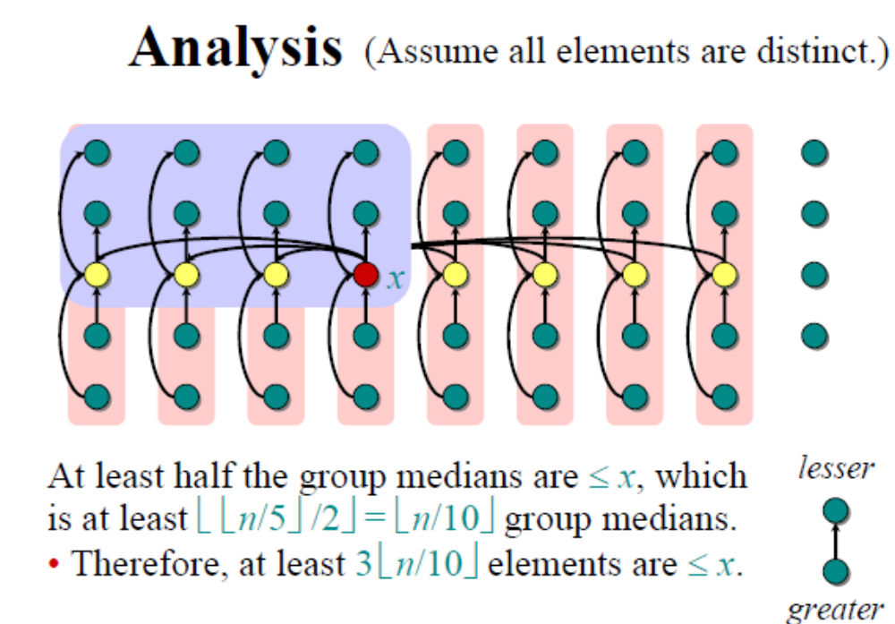
Software College, Northeast University neuzl@163.com

Slide 94
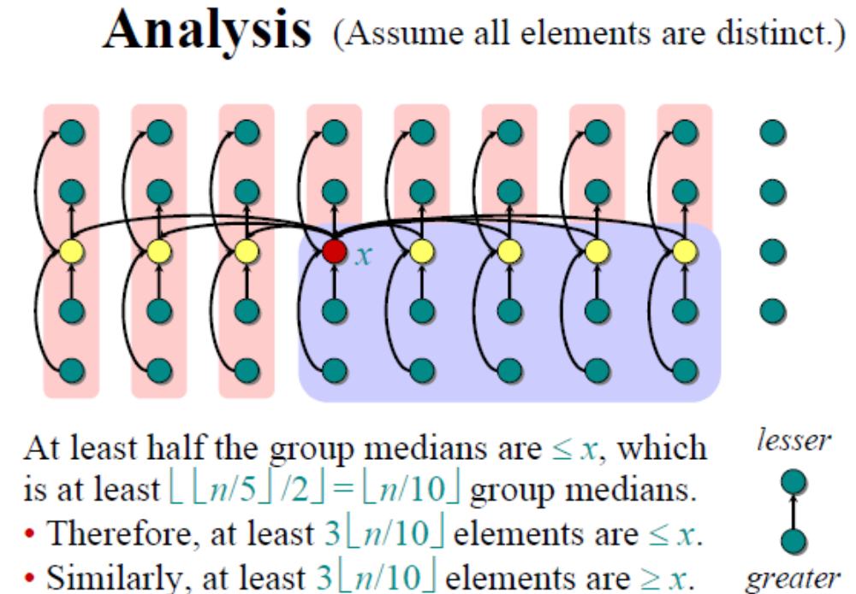
Software College, Northeast University neuzl@163.com

Slide 95
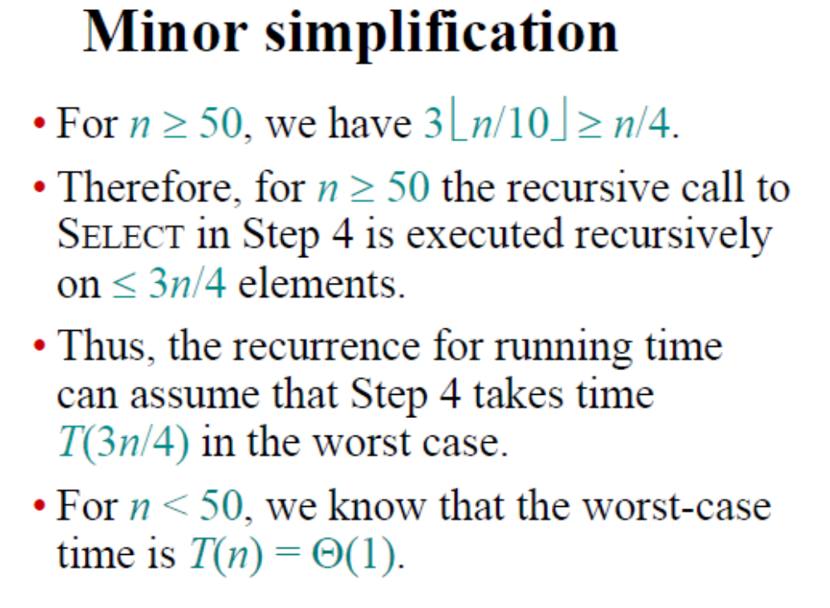
Software College, Northeast University neuzl@163.com

Slide 96
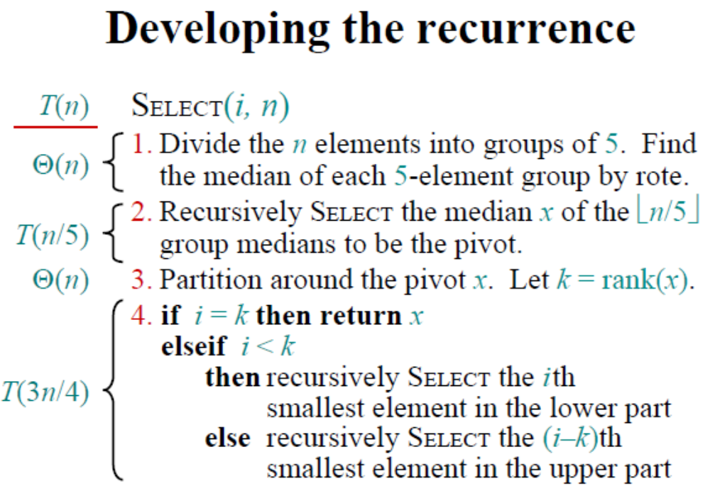
Software College, Northeast University neuzl@163.com

Slide 97
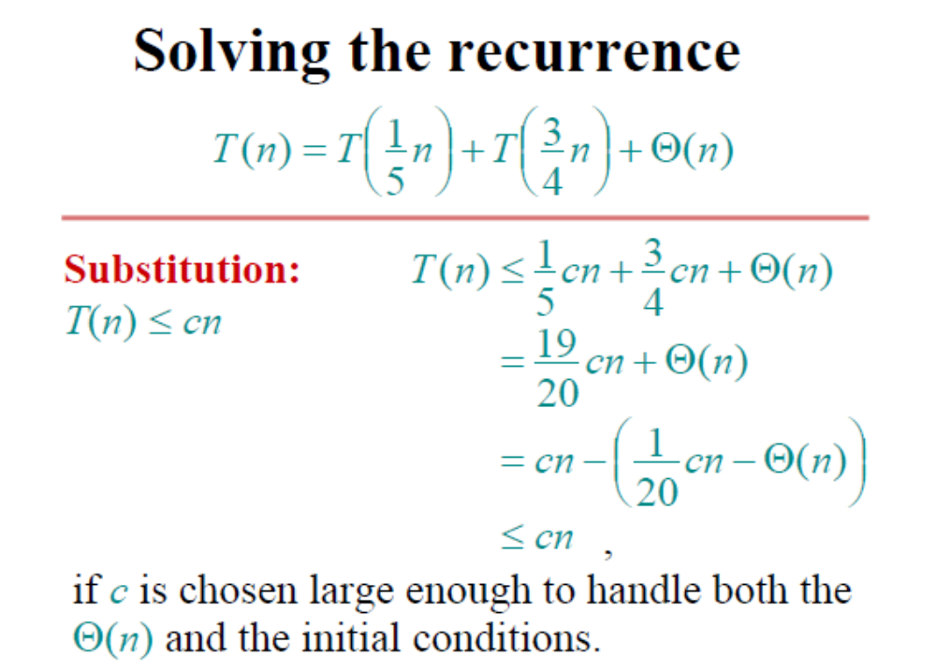
Software College, Northeast University neuzl@163.com

Slide 98
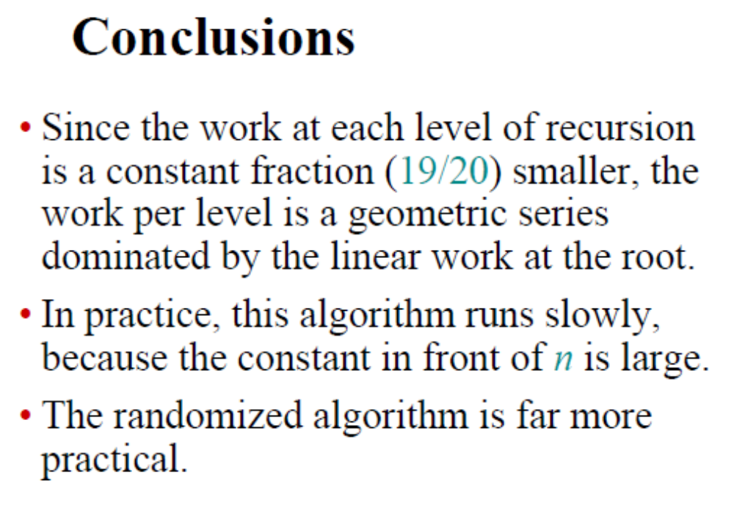
Software College, Northeast University neuzl@163.com

Slide 99
自学
最接近点对问题及循环赛日程表
作业
教材P37页，2-15
Software College, Northeast University neuzl@163.com

